Slide 1
TENSOR ALGEBRA

Slide 2
Matrices
the size of the matrix in terms of a pair m × n
Size 1 × n (b₁ b₂ … b_{n}) - row matrices
Size 3 × 1 -
- column matrices

Slide 3
Identity (like 1) matrices are also distinguished;
by definition, these are square matrices (n × n) of the form

Slide 4
Einstein (dummy or mute) summation
Remark
Any index including the one used for summation does not appear more than twice

Slide 5
Kronecker symbol ("delta-symbol")
Remark
The dummy index is effectively "killed" when summed with the Kronecker symbol ("delta-symbol"):
δ_{ik}х_{kl} = (δ_{i1}х_{1l} + δ_{i2}х_{2l} + δ_{i3}х_{3l} ) = х_{il}.

Slide 6


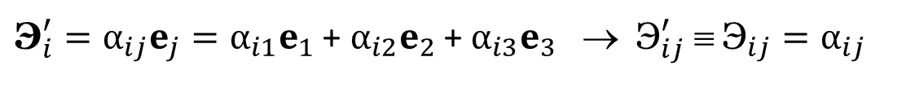




Orthogonal Transformations of Coordinates
x₃
$$x_{3}^{′}$$
e₃
$$e_{3}^{′}$$
$$x_{2}^{′}$$
$$e_{2}^{′}$$
e₂
e₁
x₂
$$e_{1}^{′}$$
$$x_{1}^{′}$$
x₁
Rule of primed indices
The first index (i) in α_{ij} corresponds to the primed basis vector
${\text{Э}}_{i}^{′}=α_{ij}e_{j}=α_{i1}e_{1}$ + $α_{i2}e_{2}$ + $α_{i3}e_{3}$ → ${\text{Э}}_{ij}^{′} ≡ {\text{Э}}_{ij}=α_{ij}$

Slide 7
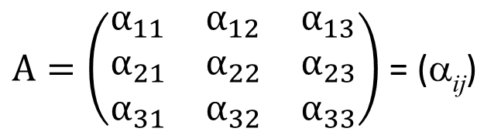
$A=\left(\begin{matrix}α_{11} & α_{12} & α_{13} \\ α_{21} & α_{22} & α_{23} \\ α_{31} & α_{32} & α_{33}\end{matrix}\right)$ = (α_{ij})
- Transformation matrix
$$e_{1}=e_{1}^{′}\cos\left\langle e_{1}^{′}e_{1}\right\rangle +e_{2}^{′}\cos\left\langle e_{2}^{′}e_{1}\right\rangle +e_{3}^{′}\cos\left\langle e_{3}^{′}e_{1}\right\rangle =α_{j1}{e′}_{j}$$
$$e_{i}=e_{1}^{′}\cos\left\langle e_{i}e_{1}^{′}\right\rangle +e_{2}^{′}\cos\left\langle {e_{i}e′}_{2}\right\rangle +e_{3}^{′}\cos\left\langle e_{i}e_{3}^{′}\right\rangle ={α_{ji}e}_{j}$$
Rule of primed indices
The first index (i) in α_{ij} corresponds to the primed basis vector
Multiplication of columns
The columns are orthonormal
Multiplication of rows
The rows are orthonormal
Definition.
Matrices with orthonormal rows and orthonormal columns are called orthonormal matrices.

Slide 8
B = A^{(Т)}, β_{ij} = α_{ji}.
B = A^{(Т)} - orthonormal
β_{ij}β_{ik} = α_{ji}α_{ki} = δ_{jk} - multiplication of j-th and k-th rows
β_{ij}β_{kj} = α_{ji}α_{jk} = δ_{ik} - multiplication of j-th and k-th columns
C = AB
c_{ij} = α_{ik} β_{kj} = α_{ik} α_{jk} = δ_{ij}
B = A^{(Т)} = A⁻¹
^{(transposed)}

Slide 9
The rule of the primed index
The first index (i) in α_{ij} corresponds to the primed basis vector

Slide 10
SCALAR
Definition
A scalar is a mathematical object such that it is described
1) by a single number r;
2) this number is the same in all coordinate systems, i.e., is invariant with respect to coordinate transformations:
r′ = r
Examples of scalars are:
Mass m
Time t
Energy E
Temperature T
Length L
etc.

Slide 11
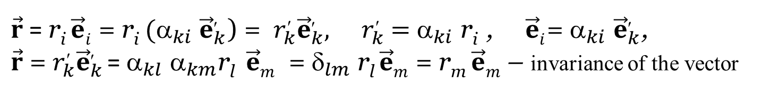
VECTOR
Definition
A vector is a mathematical object r such that :
It is described by three numbers
r₁, r₂, r₃
2) Under coordinate transformations, these numbers (called the components of the vector) change according to the law:
$\vec{r}$ = r_{i} $\vec{e}i$ = r_{i} ${\text{(}\text{α}}_{ki}$ ${\vec{e}}_{k}^{′}$) = $r_{k}^{′}{\vec{e}}_{k}^{′},{ r}_{k }^{′}=$ ${\text{}}_{ki}$ r_{i} , $\vec{e}i$= ${\text{}}_{ki}$ ${\vec{e}}_{k}^{′}$,
$\vec{r}$ = $r_{k}^{′}{\vec{e}}_{k}^{′}$= ${\text{}}_{kl}$ ${\text{}}_{km}$r_{l} $\vec{e}m$ = $_{lm}$ r_{l} $\vec{e}m$ = r_{m} $\vec{e}m$ – invariance of the vector
Examples of scalars are:
Velocity
Displacement w
Radius-vector r
Angular velocity Ω
etc.

Slide 12
Scalar product
Definition
A scalar product (or dot product) of the vectors a and b is a (scalar) number equal to the product of their lengths a = |a| and b = |b| times the cosinus of the angle between them:
(a⋅b) = a b cosα
a
α
b
(a⋅b) = (b⋅a)
For an orthonormal basis
(a⋅b) = а₁b₁ + а₂b₂ + а₃b₃ ≡ а_{k}b_{k}.

Slide 13
clockwise
Vector product
Definition
[a × b] = c - vector
1) ⏐c⏐= a b sinα = S(paralelogram ab)
2) c a, c b
a
S(paralelogram ab)
b
α
c
Сounterclockwise
3)The rotation of the first vector (a) to the side of the second one (b) along the shortest arc would occur in the same direction as the rotation of e₁ to the side of e₂ by an angle of viewed from the end of the basis vector e₃.
e₃
e₂
e₁
Anti-commutativity: [a × b] = – [b × a]
Сounterclockwise
= e₁(a₂b₃ − a₃b₂) − e₂(a₁b₃ − a₃b₁) + e₃(a₁b₂ − a₂b₁)

Slide 14
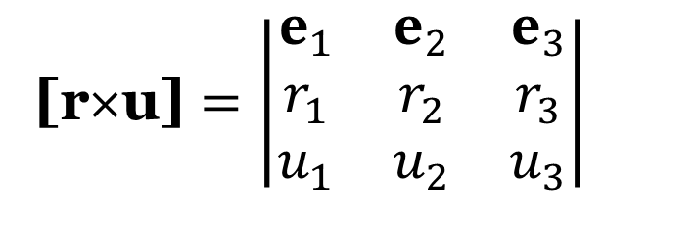
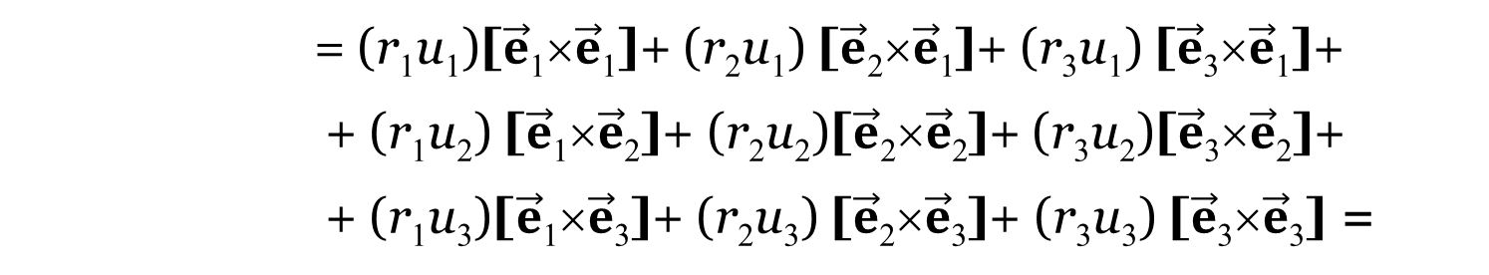
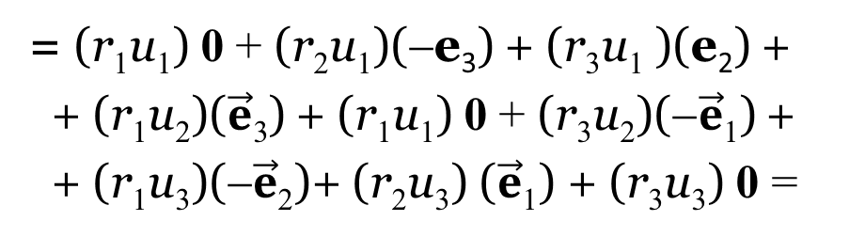
[r×u] = [r_{i} $\vec{e}i$ × u_{k} $\vec{e}k$]= [(r₁ $\vec{e}\text{1}$+ r₂ $\vec{e}\text{2}$+ r₃ $\vec{e}\text{3}$)×(u₁ $\vec{e}\text{1}$+ u₂ $\vec{e}\text{2}$+ u₃ $\vec{e}\text{3}$)]=
= (r₁u₁)[$\vec{e}\text{1}\text{×}\vec{e}\text{1}$]+ (r₂u₁) [$\vec{e}\text{2}\text{×}\vec{e}\text{1}$]+ (r₃u₁) [$\vec{e}\text{3}\text{×}\vec{e}\text{1}$]+
+ (r₁u₂) [$\vec{e}\text{1}\text{×}\vec{e}\text{2}$]+ (r₂u₂)[$\vec{e}\text{2}\text{×}\vec{e}\text{2}$]+ (r₃u₂)[$\vec{e}\text{3}\text{×}\vec{e}\text{2}$]+
+ (r₁u₃$\text{)}\text{[}\vec{e}\text{1}\text{×}\vec{e}\text{3}$]+ (r₂u₃) [$\vec{e}\text{2}\text{×}\vec{e}\text{3}$]+ (r₃u₃) [$\vec{e}\text{3}\text{×}\vec{e}\text{3}$] =
e₃
e₂
e₁
= (r₁u₁) 0 + (r₂u₁)(−e₃) + (r₃u₁ )(e₂) +
+ (r₁u₂)($\vec{e}\text{3}$) + (r₁u₁) 0 + (r₃u₂)($\vec{e}\text{1}\text{)}$ +
+ (r₁u₃$\text{)(}−\vec{e}\text{2}\text{)}$+ (r₂u₃) ($\vec{e}\text{1}\text{)}$ + (r₃u₃) 0 =
[r×u] = e₁(r₂u₃ − r₃u₂) − e₂(r₁u₃ − r₃u₁) + e₃(r₁u₂ − r₂u₁)
[r×u] $=\left|\begin{matrix}e_{1} & e_{2} & e_{3} \\ r_{1} & r_{2} & r_{3} \\ u_{1} & u_{2} & u_{3}\end{matrix}\right|$

Slide 15
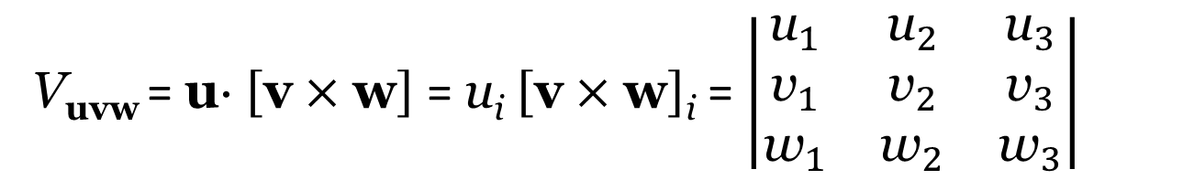
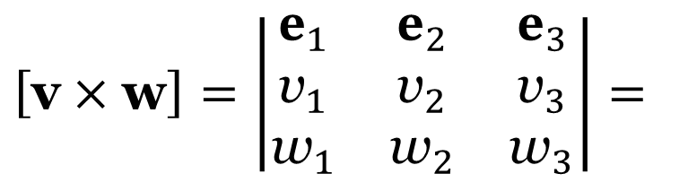


$$\left[\text{v}×\text{w}\right]=\left|\begin{matrix}e_{1} & e_{2} & e_{3} \\ {\text{v}}_{1} & {\text{v}}_{2} & {\text{v}}_{3} \\ {\text{w}}_{1} & {\text{w}}_{2} & {\text{w}}_{3}\end{matrix}\right|=$$
V_{uvw} = u⋅ $\left[\text{v}×\text{w}\right]$ = u_{i} $\left[\text{v}×\text{w}\right]$_{i} = $\left|\begin{matrix}{\text{u}}_{1} & {\text{u}}_{2} & {\text{u}}_{3} \\ {\text{v}}_{1} & {\text{v}}_{2} & {\text{v}}_{3} \\ {\text{w}}_{1} & {\text{w}}_{2} & {\text{w}}_{3}\end{matrix}\right|$
V_{uvw} > 0 - orientation of u, v , w, as e₁ , e₂ , e₃.
V_{uvw} < 0 - orientation of u, v , w, oposite to e₁ , e₂ , e₃
e₃
$$\text{w}$$
e₂
$$\text{v}$$
e₁
u

Slide 16
DYAD
Definition.
For any pair of vectors (say, r and u), a dyad or a dyadic product is introduced as a new mathematical object (neither a scalar nor a vector) that is not commutative (ru ≠ ur unless u = r), but has a linear behavior, viz.:
Not commutative
ru ≠ ur unless u = r
2) Linear behavior
(λ⁽¹⁾r⁽¹⁾ + λ⁽²⁾r⁽²⁾)(β⁽¹⁾u⁽¹⁾ + β⁽²⁾u⁽²⁾) =
= λ⁽¹⁾β⁽¹⁾(r⁽¹⁾u⁽¹⁾) + λ⁽²⁾β⁽¹⁾(r⁽²⁾u⁽¹⁾) + λ⁽¹⁾β⁽²⁾(r⁽¹⁾u⁽²⁾) + λ⁽²⁾β⁽²⁾(r⁽²⁾u⁽²⁾).

Slide 17
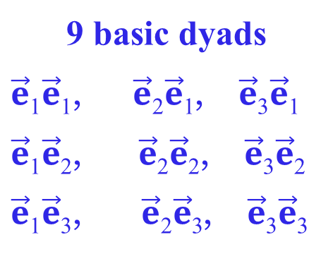
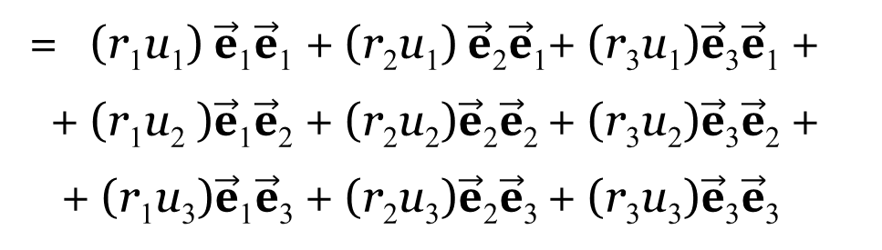
DYAD
ru = r_{i} $\vec{e}i$ u_{k} $\vec{e}k$= (r₁ $\vec{e}\text{1}$+ r₂ $\vec{e}\text{2}$+ r₃ $\vec{e}\text{3}$) (u₁ $\vec{e}\text{1}$+ u₂ $\vec{e}\text{2}$+ u₃ $\vec{e}\text{3}$)=
= (r₁u₁) $\vec{e}\text{1}\vec{e}\text{1}$ + (r₂u₁) $\vec{e}\text{2}\vec{e}\text{1}$+ (r₃u₁)$\vec{e}\text{3}\vec{e}\text{1}$ +
+ (r₁u₂ )$\vec{e}\text{1}\vec{e}\text{2}$ + (r₂u₂)$\vec{e}\text{2}\vec{e}\text{2}$ + (r₃u₂)$\vec{e}\text{3}\vec{e}\text{2}$ +
+ (r₁u₃$\text{)}\vec{e}\text{1}\vec{e}\text{3}$ + (r₂u₃)$\vec{e}\text{2}\vec{e}\text{3}$ + (r₃u₃)$\vec{e}\text{3}\vec{e}\text{3}$
9 basic dyads
$\vec{e}\text{1}\vec{e}\text{1}$, $\vec{e}\text{2}\vec{e}\text{1}$, $\vec{e}\text{3}\vec{e}\text{1}$
$\vec{e}\text{1}\vec{e}\text{2}$, $\vec{e}\text{2}\vec{e}\text{2}$, $\vec{e}\text{3}\vec{e}\text{2}$
$\vec{e}\text{1}\vec{e}\text{3}$, $\vec{e}\text{2}\vec{e}\text{3}$, $\vec{e}\text{3}\vec{e}\text{3}$

Slide 18
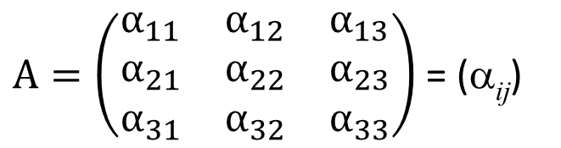
Second-Rank Tensors
$A=\left(\begin{matrix}α_{11} & α_{12} & α_{13} \\ α_{21} & α_{22} & α_{23} \\ α_{31} & α_{32} & α_{33}\end{matrix}\right)$ = (α_{ij})
Definition.
Second-rank tensor T is an object such that:
In any fixed coordinate system, it is described by 9 numbers forming a 3 × 3 matrix of its components
2) when the coordinate system is changed, the matrix of its components is transformed according to the law
thus ensuring its invariance.

Slide 19
T′ = ATA^{–1}
Det T′ = det(ATA^{–1}) = det A det T det A^{–1} = det T
(det A det A^{–1} = det (AA^{–1}) = det E = 1).
Theorem
The determinant of the tensor matrix T remains the same after passing to another orthonormal coordinate system (though the matrix itself does change after it):
det T′ = det T

Slide 20
Tensor of n-th rank
Definition.
An n-th rank tensor is a mathematical object T^{(n)} = T_{ij … p} e_{i} e_{j} … e_{p} such that:
1) In a certain fixed coordinate system with the basis vectors e₁, e₂, e₃, it is described by 3^{n} numbers;
2) When passing to a new basis these numbers are changing in accordance with a law that ensures the invariance of the tensor with respect to coordinate transformations:
(i, j, … p, k, l, … r = 1, 2, 3).

Slide 21
1. Addition
T = P + S, then
T _{kl … r} = P _{kl … r} + S_{kl … r}
2. Polyadic product
T = T_{ij} e_{i}e_{j} - tensor
r = r_{k} e_{k} - vector
in a certain coordinate system,
Polyadic product (P = Tr)
yields a third-rank tensor equal to
P = T_{ij} r_{k} e_{i}e_{j}e_{k}

Slide 22
3. Contruction product
T = T_{ij} e_{i}e_{j} - tensor
r = r_{k} e_{k} - vector
Polyadic product P = T⋅ r
yields a third-rank tensor equal to
P = T_{ij} e_{i}e_{j} ⋅ r_{k} e_{k} = T_{ij} r_{k} e_{i}(e_{j} ⋅ e_{k})=
= T_{ij} r_{k} e_{i} (δ_{jk}) = T_{ij} r_{j} e_{i} =,
1) P_{i} = T_{ij} r_{j} - 3¹ components,
in a certain coordinate system,

Slide 23
Theorem on the Contraction
1. Contraction (convolution) by two tensors leads to tensor
A = A_{ijk}e_{i}e_{j}e_{k} - third-rank tensor
B = B_{mn}e_{m}e_{n} - second-rank tensor.
c_{i} is 3 numbers in the coordinate system e₁ ,e₂ , e₃
with transformation rule under change to any
If c_{i} = A_{ijk}B_{jk} in any coordinate system,
Then, c_{i} e_{i} is a first-rank tensor (vector).

Slide 24
Theorem of the Scalar Division
1) If A = A_{ijk} - 27 numbers in the coordinate system e₁ ,e₂ , e₃
with some transformation rule under change to any
2) If for any vectors u = u_{i} e_{i}, v = v_{j} e_{j} , w = w_{k}e_{k}.
the contraction A_{ijk}u_{i} v_{j} w_{k} be a scalar
Then A_{ijk}e_{i}e_{j}e_{k} is the third-rank tensor,
$$\text{As} A_{ijk}^{′}{\text{u}}_{i}^{′}{\text{v}}_{j}^{′}{\text{w}}_{k}^{′}=A_{pqr}{\text{u}}_{p}{\text{v}}_{q}{\text{w}}_{r}=A_{pqr}(α_{ip}{\text{u}}_{i}^{′})(α_{jq}{\text{v}}_{j}^{′})(α_{kr}{\text{w}}_{k}^{′})$$

Slide 25
Theorem of the Vector Division
1) If A = A_{ijk} are 27 numbers in the coordinate system e₁,e₂, e₃
with some transformation rule under change to any
2) For any tensor B = B_{mn}e_{m}e_{n}
the contraction с_{k} = A_{ijk}B_{ij} is a vector
Then A_{ijk}e_{i}e_{j}e_{k} is the third-rank tensor,

Slide 26
Kronecker Tensor
Let tensor δ equals δ_{ij} e_{i}e_{j} in the coordinate system e₁, e₂ , e₃
Theorem. Matrix of the δ-tensor is the same in all coordinate systems
P = λ δ

Slide 27
Levi-Civita Tensor
Definition.
27 components of a mathematical object ε_{ijk} called a Levi-Civita symbol are defined as follows in any orthogonal coordinate system:
ε_{ijk} = =
ε₁₂₃ = ε₂₃₁ = ε₃₁₂ = 1,
ε₁₃₂ = ε₃₂₁ = ε₂₁₃ = –1,
1
2
–
+
3
ε₁₁₁ = ε₁₁₂ = ε₁₁₃ = ε₂₂₁ = ε₂₂₂ = ε₂₂₃ = ε₃₃₁ = ε₃₃₂ = ε₃₃₃ =
= ε₁₂₁ = ε₁₃₁ = ε₂₁₂ =ε₂₃₂ = ε₃₁₃ = ε₃₂₃ =
= ε₁₂₂ = ε₁₃₃ = ε₂₁₁ = ε₂₃₃ = ε₃₁₁ = ε₃₂₂ = 0.

Slide 28
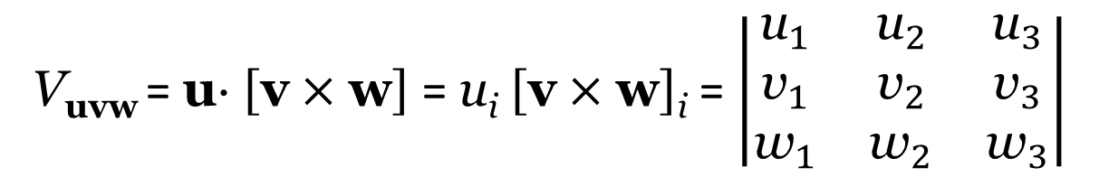
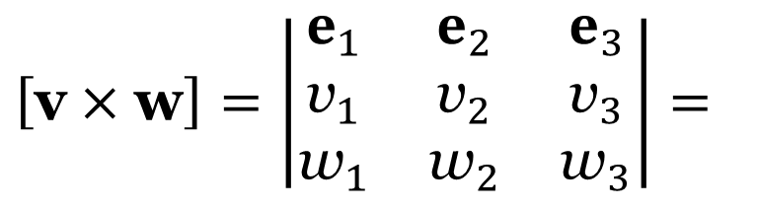
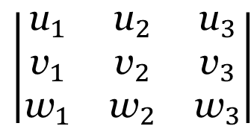
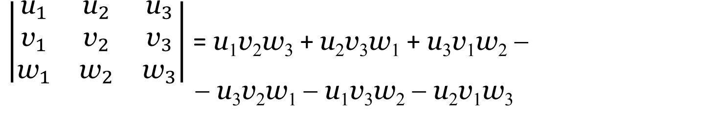
$$\left[\text{v}×\text{w}\right]=\left|\begin{matrix}e_{1} & e_{2} & e_{3} \\ {\text{v}}_{1} & {\text{v}}_{2} & {\text{v}}_{3} \\ {\text{w}}_{1} & {\text{w}}_{2} & {\text{w}}_{3}\end{matrix}\right|=$$
V_{uvw} = u⋅ $\left[\text{v}×\text{w}\right]$ = u_{i} $\left[\text{v}×\text{w}\right]$_{i} = $\left|\begin{matrix}{\text{u}}_{1} & {\text{u}}_{2} & {\text{u}}_{3} \\ {\text{v}}_{1} & {\text{v}}_{2} & {\text{v}}_{3} \\ {\text{w}}_{1} & {\text{w}}_{2} & {\text{w}}_{3}\end{matrix}\right|$
V_{uvw} > 0 - orientation of u, v , w, as e₁ , e₂ , e₃.
V_{uvw} < 0 - orientation of u, v , w, opposite to e₁ , e₂ , e₃
$\left|\begin{matrix}{\text{u}}_{1} & {\text{u}}_{2} & {\text{u}}_{3} \\ {\text{v}}_{1} & {\text{v}}_{2} & {\text{v}}_{3} \\ {\text{w}}_{1} & {\text{w}}_{2} & {\text{w}}_{3}\end{matrix}\right|$ = u₁v₂w₃ + u₂v₃w₁ + u₃v₁w₂ −
− u₃v₂w₁ − u₁v₃w₂ − u₂v₁w₃
ε₁₂₃ ε₂₃₁ ε₃₁₂
= ε_{ijk}u_{i} v_{j} w_{k}
ε₃₂₁ ε₁₃₂ ε₂₁₃
1
2
$$\left|\begin{matrix}{\text{u}}_{1} & {\text{u}}_{2} & {\text{u}}_{3} \\ {\text{v}}_{1} & {\text{v}}_{2} & {\text{v}}_{3} \\ {\text{w}}_{1} & {\text{w}}_{2} & {\text{w}}_{3}\end{matrix}\right|$$
= ε_{ijk}u_{i} v_{j} w_{k}
–
+
3
V_{uvw} = ε_{ijk}u_{i} v_{j} w_{k}

Slide 29
Scalar division theorem
ε_{ijk} are 27 numbers in the coordinate system e₁ ,e₂ , e₃
with transformation rule under change to any
For any vectors u = u_{i} e_{i}, v = v_{j} e_{j} , w = w_{k}e_{k}.
V_{uvw}
= ε_{ijk}u_{i} v_{j} w_{k}
V_{uvw} > 0 or V_{uvw} < 0 - orientation of u, v , w
V_{uvw} = ε_{ijk}u_{i} v_{j} w_{k} - scalar for any e₁ ,e₂ , e₃
Then E = ε_{ijk}e_{i} e_{j} e_{k} - tensor of 3-rd rank

Slide 30
Vector product
[a×b]_{i} = ε_{ijk}a_{j}b_{k}.
[a×b] = = ε_{ijk}a_{j}b_{k}e_{i} .
ε_{ijk}ε_{ijk} = 6
ε_{ijk}ε_{ijn} = ε_{kij}ε_{nij} = 2δ_{kn}
ε_{ijk}ε_{lmk} ≡ ε_{kij}ε_{klm} = δ_{il} δ_{jm} – δ_{im}δ_{jl}

Slide 31
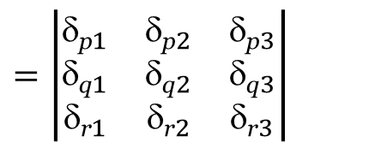
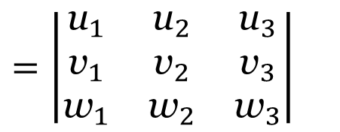
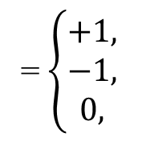
The volume of the parallelepiped
spanned by vectors u = u_{i} e_{i}, v = v_{j} e_{j} , w = w_{k}e_{k}
u v w
V_{uvw} = det
The volume of the rectangular parallelepiped
spanned by basis vectors
u = e_{p} = δ_{pi} e_{i} = δ_{p1}e₁ + δ_{p2}e₂ + δ_{p3}e₃ , v = e_{q} = δ_{qj} e_{j} , w = e_{r} = δ_{rk} e_{k}
→
→
→
→
→
→
→
→
→
→
→
$$=\left|\begin{matrix}{\text{u}}_{1} & {\text{u}}_{2} & {\text{u}}_{3} \\ {\text{v}}_{1} & {\text{v}}_{2} & {\text{v}}_{3} \\ {\text{w}}_{1} & {\text{w}}_{2} & {\text{w}}_{3}\end{matrix}\right|$$
$$=\left|\begin{matrix}{\text{}\text{p}}_{1} & {\text{}\text{p}}_{2} & {\text{}\text{p}}_{3} \\ {\text{}\text{q}}_{1} & {\text{}\text{q}}_{2} & {\text{}\text{q}}_{3} \\ {\text{}\text{r}}_{1} & {\text{}\text{r}}_{2} & {\text{}\text{r}}_{3}\end{matrix}\right|$$
V_{uvw} =
= ε_{pqr}
= ε_{pqr}
= $\left\{\begin{aligned}+1, \\ −1, \\ 0, \end{aligned}\right.$
$$\text{permutation}\text{ (}\text{p}\text{, }\text{q}\text{, }\text{r}\text{) = (1, 2, 3), (2, 3, 1), (3, 1, 2),}$$
e_{p}, e_{q} , e_{r}
→
→
→
$$\text{permutation} \text{(}\text{p}\text{, }\text{q}\text{, }\text{r}\text{) = (1, 3, 2), (3, 2, 1), (2, 3, 1),}$$
$$\text{combimations} \text{with} \text{repited} \text{indexe}\text{s} \text{from} \text{1, 2,} \text{3}$$

Slide 32
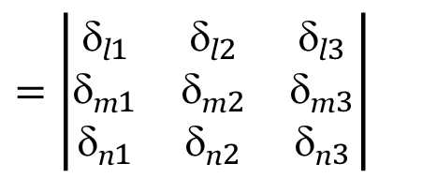
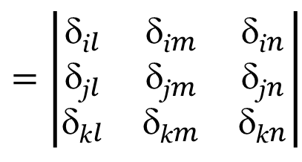
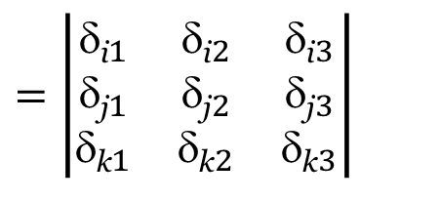
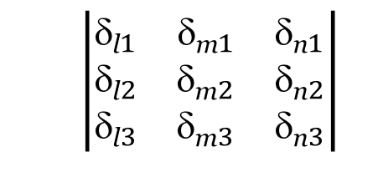
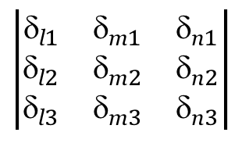
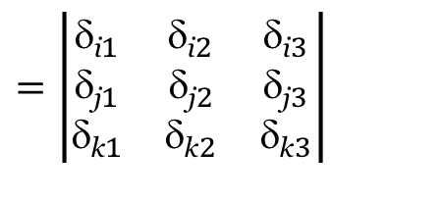
$$=\left|\begin{matrix}{\text{}\text{i}}_{1} & {\text{}\text{i}}_{2} & {\text{}\text{i}}_{3} \\ {\text{}\text{j}}_{1} & {\text{}\text{j}}_{2} & {\text{}\text{j}}_{3} \\ {\text{}\text{k}}_{1} & {\text{}\text{k}}_{2} & {\text{}\text{k}}_{3}\end{matrix}\right|$$
$$=\left|\begin{matrix}{\text{}\text{l}}_{1} & {\text{}\text{l}}_{2} & {\text{}\text{l}}_{3} \\ {\text{}\text{m}}_{1} & {\text{}\text{m}}_{2} & {\text{}\text{m}}_{3} \\ {\text{}\text{n}}_{1} & {\text{}\text{n}}_{2} & {\text{}\text{n}}_{3}\end{matrix}\right|$$
$$\left|\begin{matrix}{\text{}\text{l}}_{1} & {\text{}\text{m}}_{1} & {\text{}\text{n}}_{1} \\ {\text{}\text{l}}_{2} & {\text{}\text{m}}_{2} & {\text{}\text{n}}_{2} \\ {\text{}\text{l}}_{3} & {\text{}\text{m}}_{3} & {\text{}\text{n}}_{3}\end{matrix}\right|$$
ε_{ijk}
ε_{lmn}
Transpose
=
$$=\left|\begin{matrix}{\text{}\text{i}}_{1} & {\text{}\text{i}}_{2} & {\text{}\text{i}}_{3} \\ {\text{}\text{j}}_{1} & {\text{}\text{j}}_{2} & {\text{}\text{j}}_{3} \\ {\text{}\text{k}}_{1} & {\text{}\text{k}}_{2} & {\text{}\text{k}}_{3}\end{matrix}\right|$$
$$\left|\begin{matrix}{\text{}\text{l}}_{1} & {\text{}\text{m}}_{1} & {\text{}\text{n}}_{1} \\ {\text{}\text{l}}_{2} & {\text{}\text{m}}_{2} & {\text{}\text{n}}_{2} \\ {\text{}\text{l}}_{3} & {\text{}\text{m}}_{3} & {\text{}\text{n}}_{3}\end{matrix}\right|$$
ε_{ijk}
ε_{lmn}
×
c¹¹ = δ_{i1}δ_{l1} + δ_{i2}δ_{l2} + δ_{i3}δ_{l3} = δ_{ip}δ_{lp} = δ_{il}
c¹² = δ_{i1}δ_{m1} + δ_{i2}δ_{m2} + δ_{i3}δ_{m3} = δ_{ip}δ_{mp} = δ_{im}
c¹³ = δ_{i1}δ_{n1} + δ_{i2}δ_{n2} + δ_{i3}δ_{n3} = δ_{ip}δ_{np} = δ_{in}
$$=\left|\begin{matrix}{\text{}\text{i}}_{l} & {\text{}\text{i}}_{m} & {\text{}\text{i}}_{n} \\ {\text{}\text{j}}_{l} & {\text{}\text{j}}_{m} & {\text{}\text{j}}_{n} \\ {\text{}\text{k}}_{l} & {\text{}\text{k}}_{m} & {\text{}\text{k}}_{n}\end{matrix}\right|$$
ε_{ijk}
ε_{lmn}
ε_{ijk}
ε_{lmn}
= δ_{il} δ_{jm}${\text{}\text{k}}_{n}$+ δ_{jl} δ_{km}${\text{}\text{i}}_{n}$+ δ_{im} δ_{jn}${\text{}}_{kl}$− ${\text{}}_{kl}$δ_{jm}${\text{}\text{i}}_{n}$ − δ_{jl}δ_{im}${\text{}}_{kn}$ − δ_{km} δ_{jn}δ_{il}

Slide 33

















ε_{ijk}
ε_{lmn}
= δ_{il} δ_{jm}${\text{}\text{k}}_{n}$+ δ_{jl} δ_{km}${\text{}\text{i}}_{n}$+ δ_{im} δ_{jn}${\text{}}_{kl}$− ${\text{}}_{kl}$δ_{jm}${\text{}\text{i}}_{n}$ − δ_{jl}δ_{im}${\text{}}_{kn}$ − δ_{km} δ_{jn}δ_{il}
ε_{ijk}
Convolution: l = i, m = j, n = k:
ε_{ijk}
= 3(1×1) + 3(−1)×(− 1) = 3 + 3 = 6
Convolution: m = j, n = k:
ε_{ijk}
ε_{ljk}
= δ_{il} δ_{jj}${\text{}\text{k}}_{k}$+ δ_{jl} δ_{kj}${\text{}\text{i}}_{k}$+ δ_{ij} δ_{jk}${\text{}}_{kl}$− ${\text{}}_{kl}$δ_{jj}${\text{}\text{i}}_{k}$ − δ_{jl}δ_{ij}${\text{}}_{kk}$ − δ_{kj} δ_{jk} δ_{il} =
9$\text{}\text{il}$
δ_{jl} ${\text{}}_{ij}=\text{δ}\text{il}$
δ_{ij} ${\text{}}_{jl}=\text{δ}\text{i}\text{l}$
δ_{𝑗𝑗} δ_{il} $=\text{3}\text{δ}\text{i}\text{l}$
3$\text{}\text{il}$
$${\text{}}_{jj}\text{δ}\text{il}=\text{3}\text{δ}\text{i}\text{l}$$
= 9δ_{il} + ${\text{}}_{li}$+ δ_{il} − ${\text{3}\text{δ}\text{i}}_{l}$ − 3 δ_{il} − 3 δ_{il} = 2δ_{il}
Convolution: n = k:
ε_{ijk}
ε_{lmk}
= δ_{il} δ_{jm}${\text{}\text{k}}_{k}$+ δ_{jl} δ_{km}${\text{}\text{i}}_{k}$+ δ_{im} δ_{jk}${\text{}}_{kl}$− ${\text{}}_{kl}$δ_{jm}${\text{}\text{i}}_{k}$ − δ_{jl}δ_{im}${\text{}}_{kk}$ − δ_{km} δ_{jk} δ_{il} =
3δ_{jm} $\text{}\text{i}\text{l}$
δ_{jl} ${\text{}}_{im}$
δ_{im} ${\text{}}_{jl}$
δ_{jm} $\text{}\text{i}\text{l}$
3δ_{jl} ${\text{}}_{im}$
δ_{jm} $\text{}\text{i}\text{l}$
= 3$\text{}\text{i}\text{l}$δ_{jm} +δ_{jl} ${\text{}}_{im}$+ δ_{im}${\text{}}_{jl}$ − ${\text{}\text{i}}_{l}$δ_{jm}− 3δ_{jl}δ_{im} − ${\text{}\text{i}}_{l}$ δ_{jm} =
= $\text{}\text{i}\text{l}$δ_{jm}
− δ_{im}${\text{}}_{jl}$
ε_{ijk}ε_{ijk} = 6
ε_{ijk}ε_{ijn} = ε_{kij}ε_{nij} = 2δ_{kn}
ε_{ijk}ε_{lmk} ≡ ε_{kij}ε_{klm} = δ_{il} δ_{jm} – δ_{im}δ_{jl}
$$\begin{matrix}i j k \\ \\ l m k\end{matrix}$$
$$\begin{matrix}i j k \\ \\ l m k\end{matrix}$$

Slide 34
T₁ = T_{i1} e_{i} = T₁₁e₁ + T₂₁e₂ + T₃₁e₃,
T₂ = T_{i2} e_{i} = T₁₂e₁ + T₂₂e₂ + T₃₂e₃,
T₃ = T_{i3} e_{i} = T₁₃e₁ + T₂₃e₂ + T₃₃e₃,
T₁ is collinear with e₁, if and only if T₂₁ = T₃₁ = 0
T₂ is collinear with e₂, if and only if T₁₂ = T₃₂ = 0
T₃ is collinear with e₃, if and only if T₁₃ = T₂₃ = 0

Slide 35
T₃
T₃
e₃
e₃
T₂
T₂
e₂
T₁
e₂
T₁
e₁
e₁

Slide 36
Definition
The direction which is given by a unit vector , and has the property that the vector projection of the tensor T on such direction is collinear with the vector
is called the principal direction (principal axis) of the tensor T, and the value λ equal to the length of this vector projection is called the principal value (eigenvalue) of the tensor T.
T_{ij} μ_{j} e_{i} = λ e_{i} , → T_{1j} μ_{j} = λμ₁ , T_{2j} μ_{j} = λμ₂ , T_{3j} μ_{j} = λμ₃
T_{ij} μ_{j} = λμ_{i} , T_{ij} μ_{j} = λδ_{ij} μ_{j}.
(T_{ij} μ_{j} – λδ_{ij} μ_{j} ) = 0 (i =1, 2, 3),

Slide 37
(T_{ij} μ_{j} – λδ_{ij} μ_{j} ) = 0 (i =1, 2, 3),
(T₁₁ – λ) μ₁ + T₁₂ μ₂ + T₁₃ μ₃ = 0,
T₂₁ μ₁ + (T₂₂ – λ) μ₂ + T₂₃ μ₃ = 0,
T₃₁ μ₁ + T₃₂ μ₂ + (T₃₃ – λ) μ₃ = 0,
μ_{i} μ _{i} = 1.
det(T_{ij} – λδ_{ij}) = 0,

Slide 38
λ³ – I₍₁₎λ² + I₍₂₎λ − I₍₃₎ = 0,
I₍₁₎ = T_{ii} ,
I₍₂₎ = M_{ii} = (T_{ii} T_{jj} – T_{ij} T_{ji}),
I₍₃₎ = det(T_{ij}),
INVARIANTS

Slide 39
Symmetric tensor
a) two distinct real roots (λ⁽²⁾ and λ⁽³⁾) each associated with its own direction given by the unit vector or ;
b) two coinciding roots (λ⁽²⁾ = λ⁽³⁾). This is possible only if
Then
All orthogonal to directions are principal

Slide 40
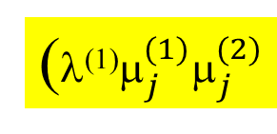


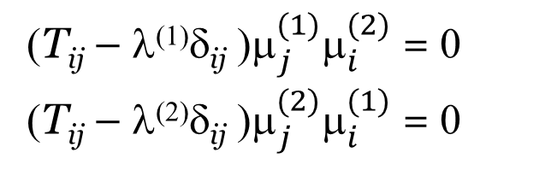
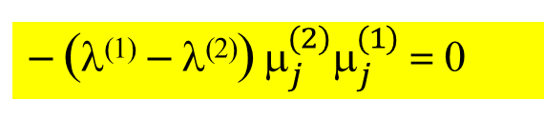
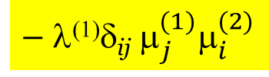
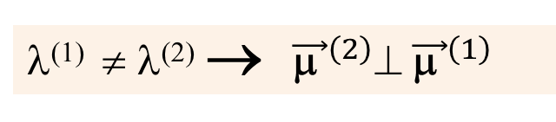
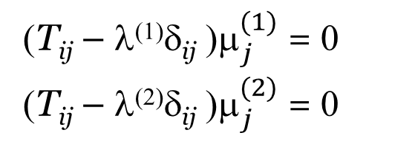



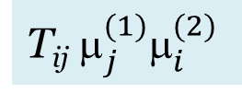
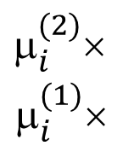
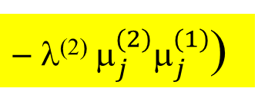
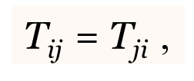
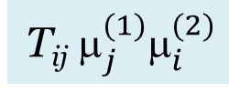


Theorem (on orthogonality). Non-equal principal values of a symmetric second-rank tensor correspond to mutually orthogonal principal axes:
T_{ij} = $\text{T}\text{j}\text{i}$,
λ⁽¹⁾ ≠ λ⁽²⁾ → ${\vec{\text{μ} }}^{\left(2\right)}⊥ {\vec{\text{μ} }}^{\left(1\right) }$
$_{i}^{(2)}$×
$_{i}^{(1)}$×
(T_{ij} – λ⁽¹⁾δ_{ij} ${\text{)}μ}_{j}^{(1)}$ = 0
(T_{ij} – λ⁽²⁾δ_{ij} ${\text{)}μ}_{j}^{(2)}$ = 0
(T_{ij} – λ⁽¹⁾δ_{ij} ${\text{)}μ}_{j}^{(1)}μ_{i}^{(2)}$ = 0
(T_{ij} – λ⁽²⁾δ_{ij} ${\text{)}μ}_{j}^{(2)}μ_{i}^{(1)}$ = 0
(i =1, 2, 3)
−
T_{ij} $_{j}^{(1)}_{i}^{(2)}$
– λ⁽¹⁾δ_{ij} $_{j}^{(1)}_{i}^{(2)}$
$$\text{–} \text{T}\text{ij}{ μ}_{j}^{(2)}μ_{i}^{(1)}$$
$$\text{+} \text{λ}\text{(2)}\text{δ}\text{ij} μ_{j}^{(2)}μ_{i}^{(1)}$$
= 0
T_{ij} $_{j}^{(1)}_{i}^{(2)}$
$$\text{–} \text{T}\text{ij} μ_{i}^{(1)}{ μ}_{j}^{(2)}$$
−
(λ⁽¹⁾$_{j}^{(1)}_{j}^{(2)}$
$\text{} \text{λ}\text{(2)} μ_{j}^{(2)}μ_{j}^{(1)}$)
= 0
T_{ij} $_{j}^{(1)}_{i}^{(2)}$– $\text{T}\text{j}iμ_{i}^{\left(1\right)}μ_{j}^{(2)}$
= T_{kl} $_{l}^{(1)}_{k}^{(2)}$–$\text{T}kl{ μ}_{l}^{\left(1\right)}$ $_{l}^{(2)}=0$
– (λ⁽¹⁾ – λ⁽²⁾)$_{j}^{(2)}_{j}^{(1)}$ = 0
if λ⁽¹⁾ ≠ λ⁽²⁾ , $\text{then}{ μ}_{j}^{(2)}μ_{j}^{(1)} \text{= }\text{0}$
$${\vec{\text{μ}}}^{\left(2\right)}⊥ {\vec{\text{μ}}}^{\left(1\right) }$$
→

Slide 41


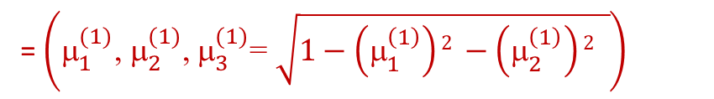

Theorem. If a symmetric second-rank tensor has three non-equal principal values λ⁽¹⁾, λ⁽²⁾, λ⁽³⁾, then these values correspond to the three mutually orthogonal principal axes , ,
such that
= λ^{(i)}
and this triplet of vectors is unique (up to the sign).
P_{μ1}
= $\left({\text{}}_{1}^{(1)}\text{, }{\text{}}_{2}^{(1)}\text{, }{\text{}}_{3}^{(1)}\text{= }\sqrt{1−\left(_{1}^{\left(1\right)}\right)2 −\left(_{2}^{\left(1\right)}\right)2 }\right)$
$${\vec{\text{μ}}}^{(1)}$$
$${\vec{\text{μ}}}^{(2)}$$
$${\vec{\text{μ}}}^{(3)}$$
Theorem. The matrix of the tensor T will be diagonal in a basis composed of the principal axes ( = = ; = = ; = =
and vice versa, if the matrix of the tensor is diagonal in a particular basis, then the basis vectors will coincide with the principal axes

